Slide 1



Social Buzz: Data Analysis & Data Insights
Notes:
30.09.2022
1

Slide 2



Today's agenda
Project recap
Problem
The Analytics team
Process
Insights
Summary
Notes:
30.09.2022
2

Slide 3

Social Buzz is a fast growing technology unicorn that need to adapt quickly to it's global scale. Accenture has begun a 3 month POC focusing on these tasks:
•An audit of Social Buzz's big data practice
•Recommendations for a successful IPO
•Analysis to find Social Buzz's top 5 most popular categories of content
Project Recap
Notes:
30.09.2022
3

Slide 4


Problem
Over 100000 posts per day
36,500,000 pieces of content per year
But how to capitalize on it when there is so much?
Analysis to find Social Buzz's top 5 most popular categories of content
Notes:
30.09.2022
4

Slide 5




ANDREW FLEMING
Chief Technology Architect
The Analytics team
LILY JOHN
Chief Technology Architect
Umairah Fodkar
Data Analyst
Notes:
30.09.2022
5

Slide 6

Process
1
Data understanding
Data cleaning
2
Data Modelling
3
Data analysis
4
5
Uncover insights
Notes:
30.09.2022
6

Slide 7

Insights
1897
16
Reaction to “Animal” post
JANUARY
Unique categories
Month with most post
Notes:
30.09.2022
7

Slide 8
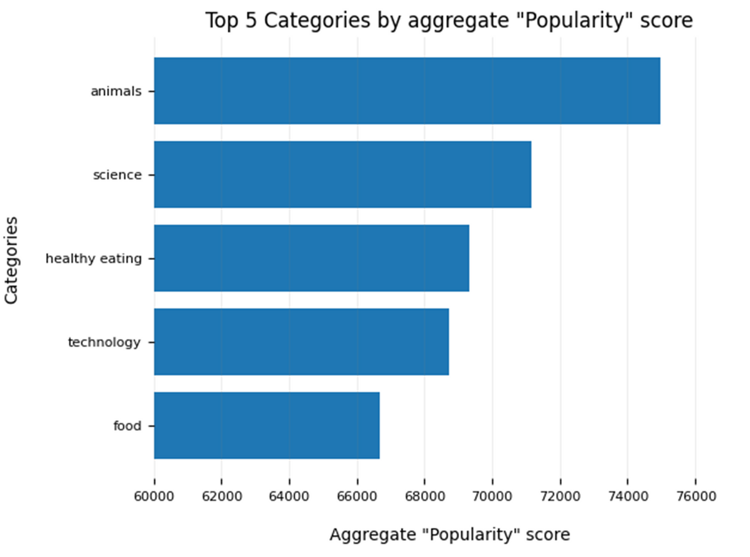

Notes:
30.09.2022
8

Slide 9
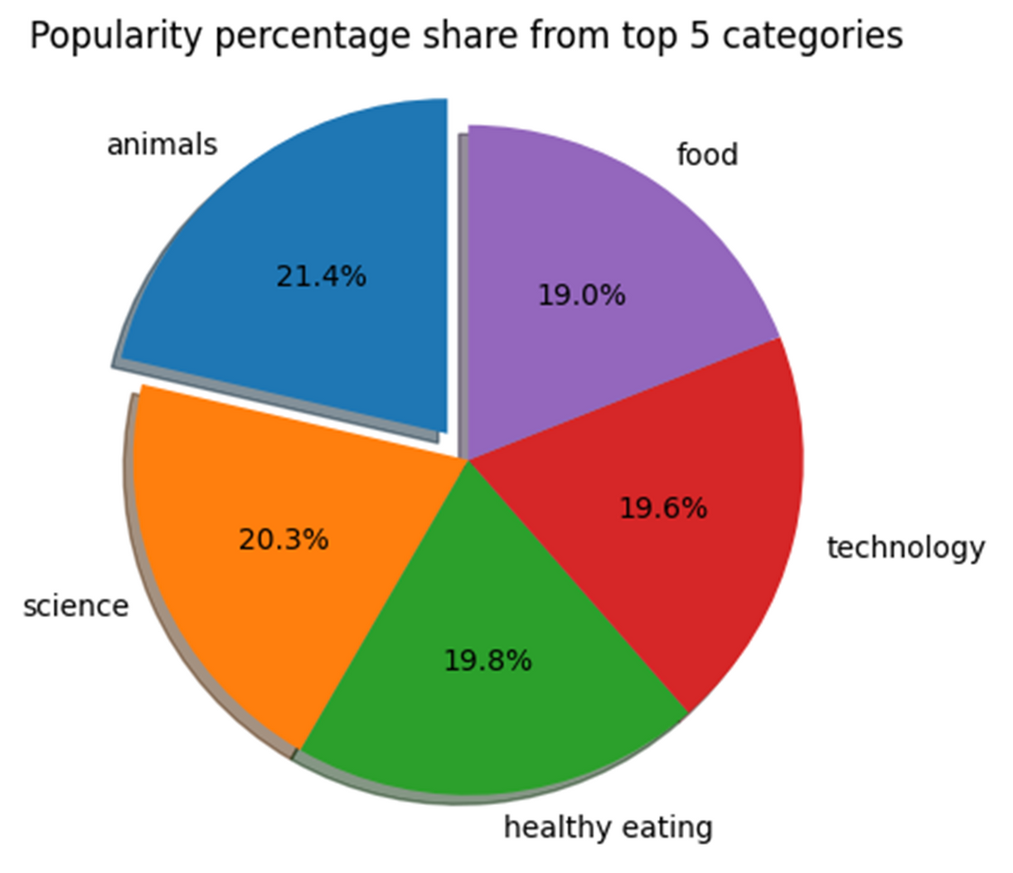
Notes:
30.09.2022
9

Slide 10


DATA ANALYSIS
Animals and science are the two most popular categories of content, showing that people enjoy "real-life" and "factual" content the most.
INSIGHT
Food is a common theme with the top 5 categories with "Healthy Eating" ranking the highest. This may give an indication to the audience within your user base. You could use this insight to create a campaign and work with healthy eating brands to boost user engagement.
Summary
NEXT STEPS
This ad-hoc analysis is insightful, but it's time to take this analysis into large scale production for real-time understanding of your business. We can show you how to do this.
Notes:
30.09.2022
10

Slide 11

Thank you!
ANY QUESTIONS?
Notes:
30.09.2022
11

